Slide 1
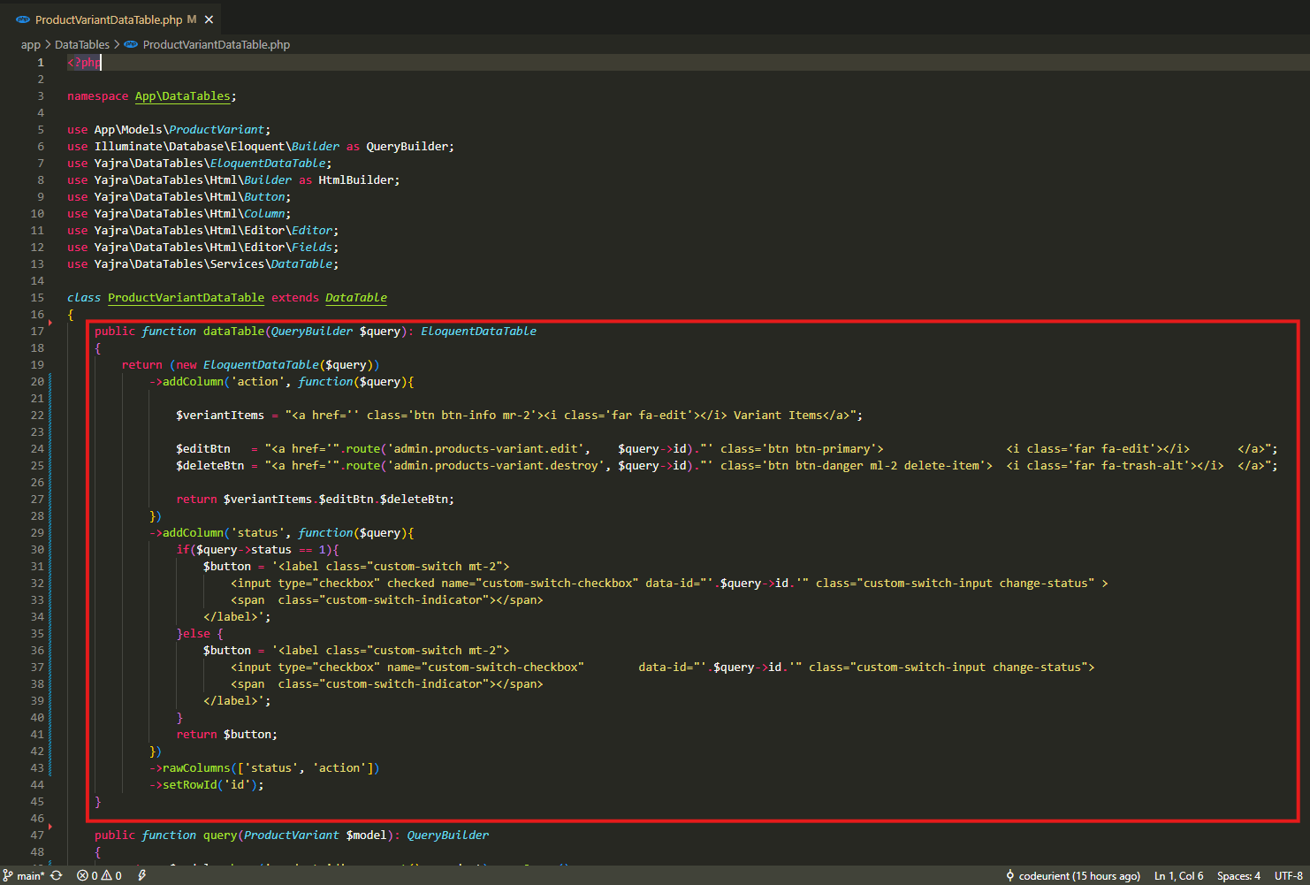
app\DataTables\ProductVariantDataTable.php

Slide 2
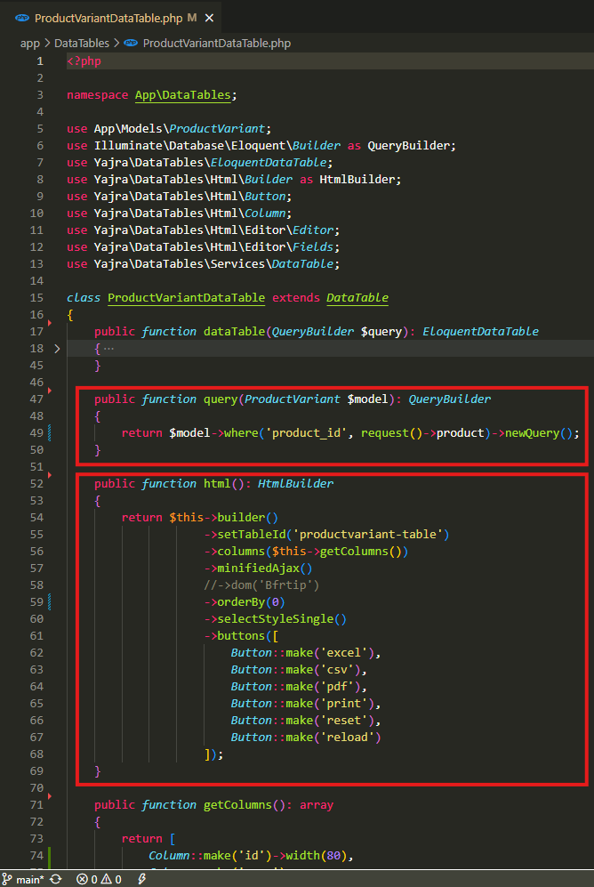
app\DataTables\ProductVariantDataTable.php

Slide 3
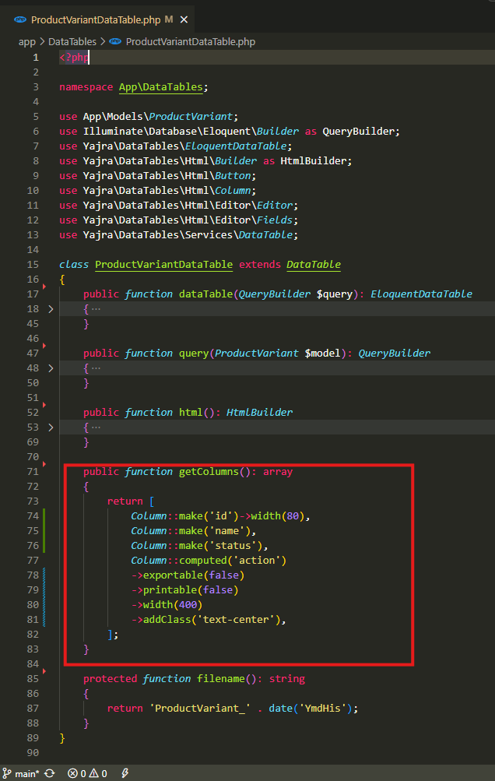
app\DataTables\ProductVariantDataTable.php

Slide 4
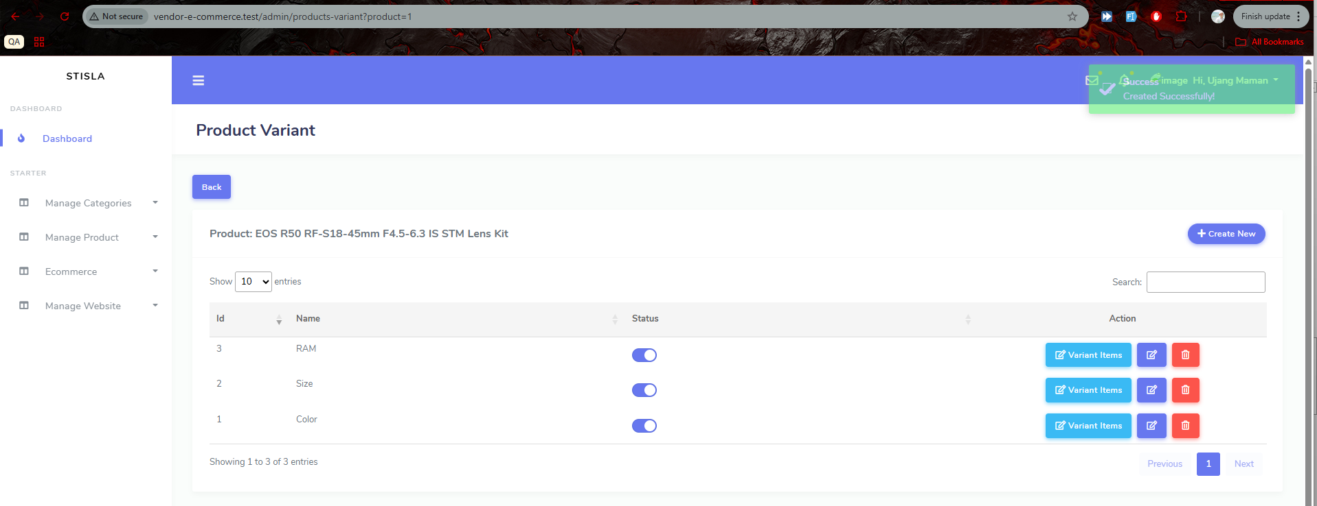
.

Slide 5
.

